Slide 1

THE RAPID HIV SEROLOGY PROFICIENCY TESTING PROGRAM, KENYA
Management and Use of PT Data
Division of National Laboratory Services
Kenya External Quality Assessment Scheme
WESTERN HEMISPHERE – PANAMA
RT-CQI BEST PRACTICES WORKSHOP
August 26 -30, 2024
Presenter Name

Slide 2
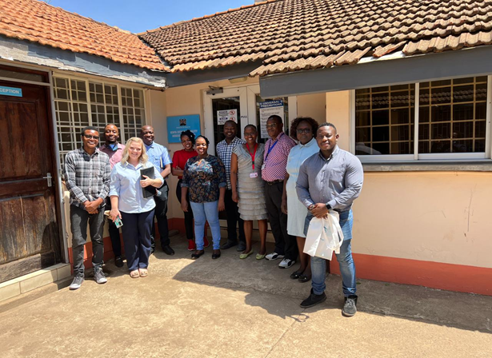
National Rapid HIV Proficiency Testing Scheme
Initiated :
Established in 2007 (facility-based) with 24 laboratories
Transitioned to individual-based PT scheme 2012
Provider:
National Public Health Laboratory through the Kenya External Quality Assessment Scheme (KNEQAS) in the HIV serology scope
Participants :
HIV testing services providers across the country
2
KNEQAS TEAM

Slide 3
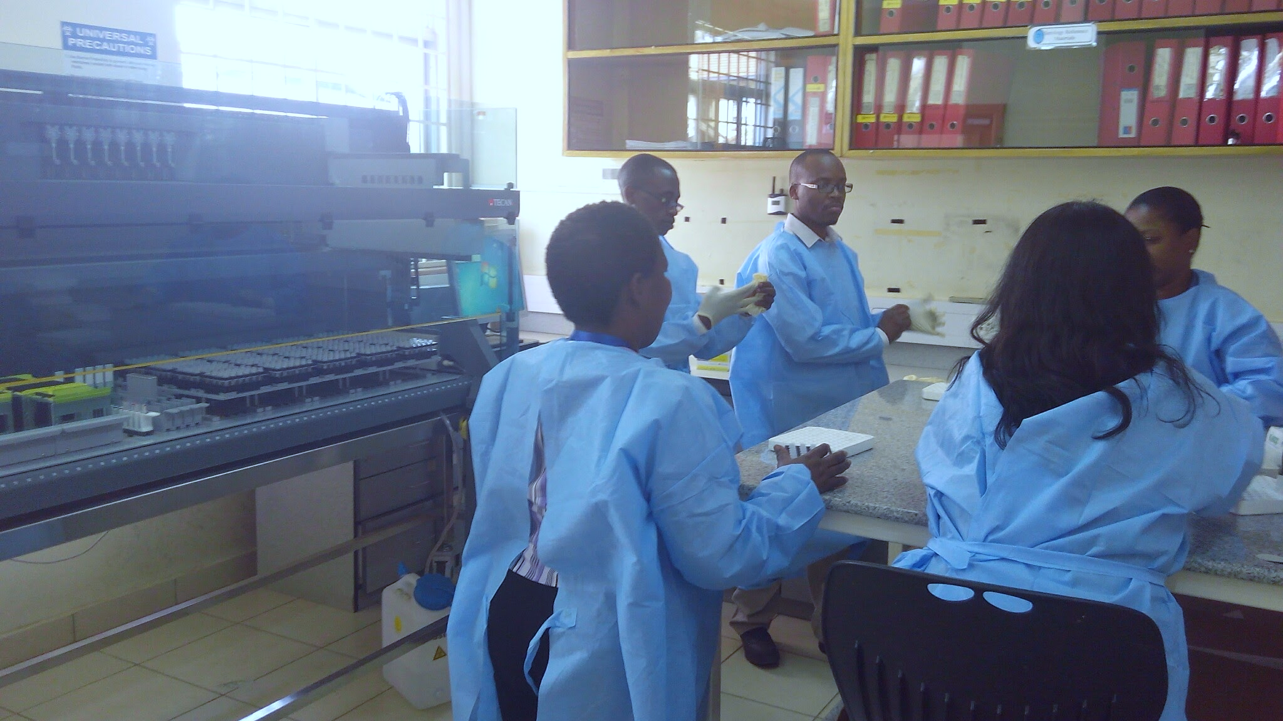
WORKLOAD
Enrollment of Participants
By 2024, 21,370 (82%) HTS providers enrolled against the programs approximated 26,000 registered personnel
Panel Production
Each participant gets six blinded Dried Tube Specimen (DTS) samples and 1 buffer (approx. 147,000 samples / round).
Scheme Schedule
Operates two rounds in a year-(June & October)
Data Processes
    Return of test results – 14 days.
    Provision of feedback reports – One Month
Corrective action
  County plan corrective action after each round.
PT PRODUCTION
3

Slide 4
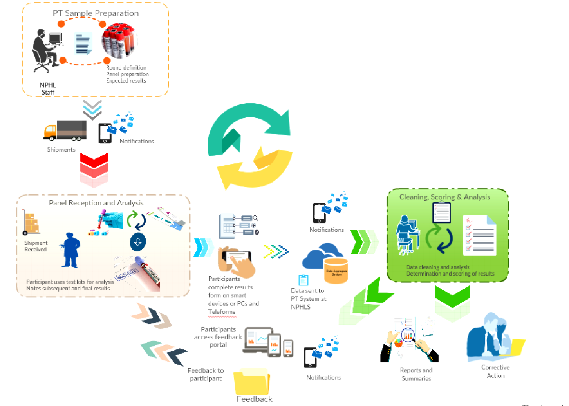
WORKFLOW
www.rhtpt.or.ke
The rapid HIV PT electronic system (E-PT) is used to manage several processes in a PT cycle
Notes:
Developed locally in collaboration with Strathmore University

Slide 5
e-PT Tool Functionality
Maintains database of HTS providers registered in PT over time
Manages enrollment of active HTS providers for each PT cycle
Provides SMS notification to service providers at various stages:
  Registration of new users
  Opening of PT cycle
  Enrolment into PT cycle
  Dispatch of PT panels
  Successful submission of PT results
  Availability of feedback reports when ready for download.
  Accessible to all registered HTS providers by logging into the web system

Slide 6
e-PT Tool Functionality
Keeps a record of panel results for evaluation
Evaluates submitted results against a set criteria
Allows for verification of the evaluated reports
Provides access for downloading individual performance reports
Overall and detailed analysis of the cycle performance at county, facility, program, designation and individual levels

Slide 7
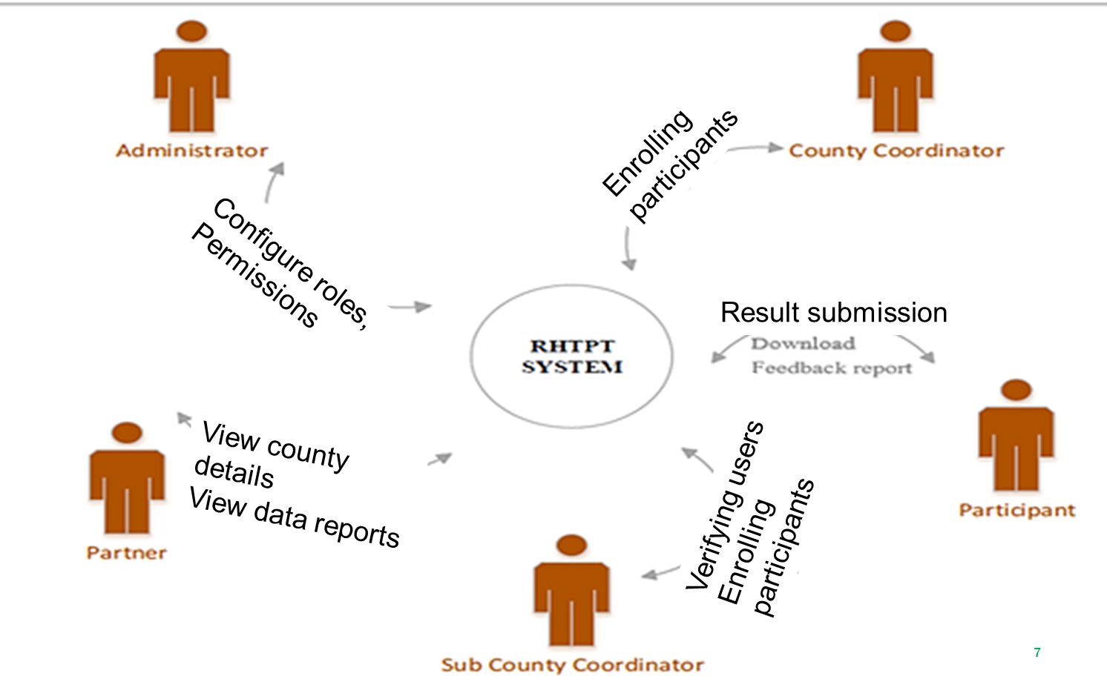
E-PT USER ROLES
E-PT

Slide 8
Data Evaluation
Correctness of results
      Ability to accurately determine HIV Sero-status of panel samples
Adherence to recommended testing algorithm
      Test kits used
      Testing sequence (serial testing)
Completeness of data
Adherence to the provided procedures.
Correct results interpretation
Completeness of results
Observance of kit expiry dates

Slide 9
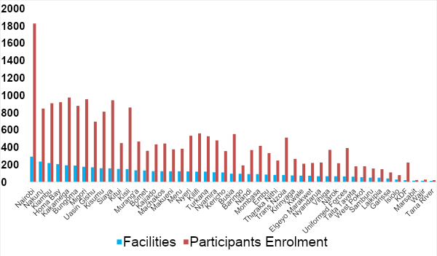

Enrollment per County, 2023
45 out of 47 counties participated in cycle
50% of participants came from 12 counties

Slide 10
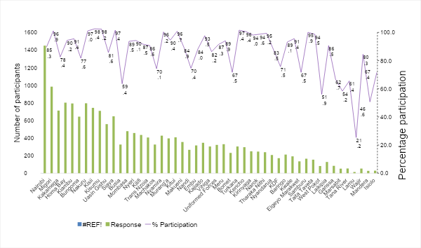
County Participation Rates, 2023
Helps in targeting counties with low participation rates
Notes:
Helps in targeting counties with low participation rates
Explain why differed responses and low participation rates and any interventions to remedy. – Numbers participating and hence response largely based on number of testes per county. Low participation rates due to:
-RTK stockouts
-Lack of support from county/IPs in accessing PT panels
-HCW strikes

Slide 11
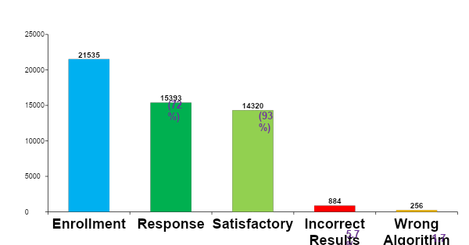
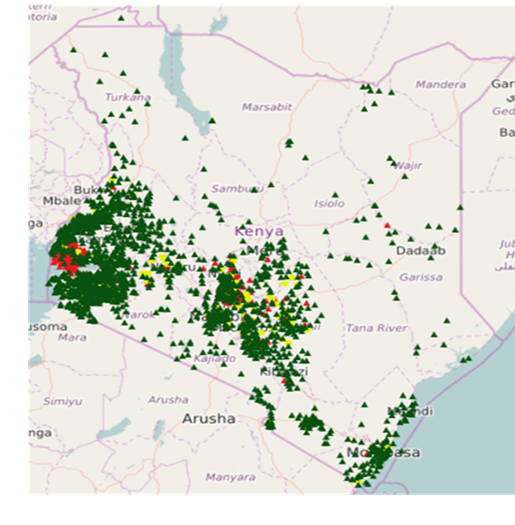
Overall Performance
11
Notes:
It took some time for supply chain to be streamlined after COVID.
Moving forward, the PT programs works closer with the supply chain team to ensure commodity availability before a PT cycle is sent out.

Slide 12
Performance by Program
Highlights of performance for different areas where testing is offered
Program | No of participants | % with Incorrect Results | % with Wrong Algorithm
PMTCT | 3501 | 9% | 2%
HBTC | 166 | 7% | 1%
PSC/CCC | 67 | 6% | 1%
PITC | 4548 | 5% | 1%
VCT | 2179 | 5% | 2%
LAB | 4931 | 4% | 2%
12
Notes:
Testing in PMTCT setting generally done by nurses. High workloads could be a reason for incorrect results.
Implications of incorrect results may result in transmission of HIV to unborn babies

Slide 13
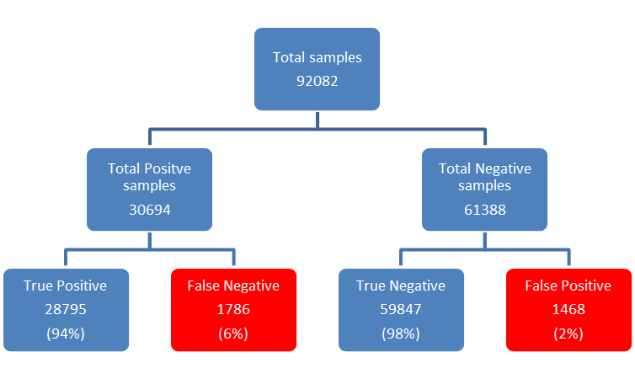
Performance by Samples Tested
Identifies:
Quality of samples provided
Challenges in ability to accurately determine HIV sero-status of samples
Samples prepared
Represents individuals who are HIV positive but given a negative result
Represents individuals who are HIV negative but given a positive result
13
Notes:
2023 data
13

Slide 14
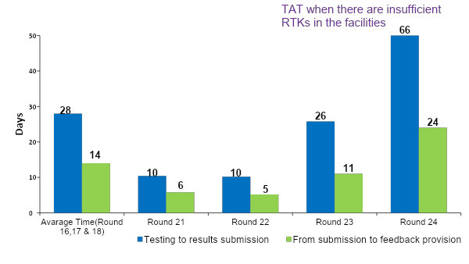
Turn-Around Times
TAT when using the Teleform system
TAT when using the e-PT

Slide 15
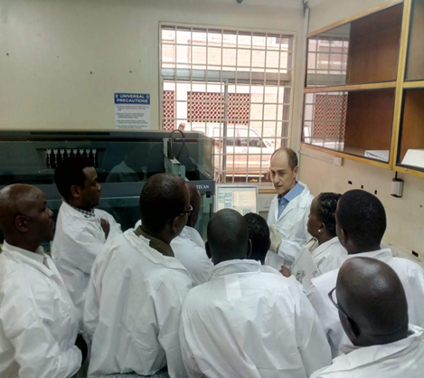

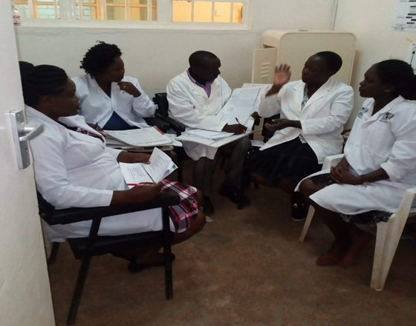

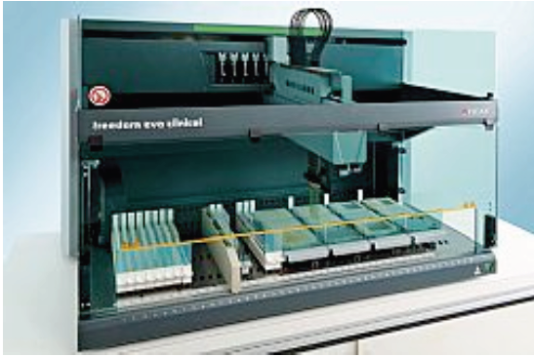
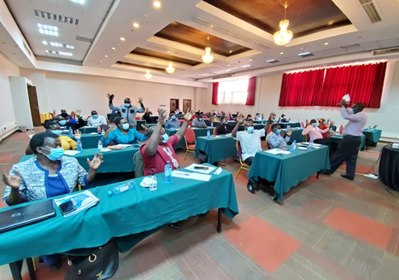
ACHIEVEMENTS
Informing Policy development
Mentorship and Training programs to facilities and County technical officers.
South-to south collaborations
ACHIEVEMENTS
Sensitization of stakeholders on their roles and effective program implementation mechanisms.
ISO 17043 accreditation
Automation of PT panel production process.

Slide 16
Lessons Learnt & Future Opportunities
Using PT data has assisted in;
      Identify gaps and challenges in the program
      determine the impact of interventions implemented.
Future opportunity is to;
Capture corrective action/preventive actions (CAPA) done in the electronic system to close the PT cycle.
System integration of all EQA scopes to ensure efficiency and scale-up.
Continuous system development to respond to the current user needs.

Slide 17

END.
Q & A

